Slide 1
Macon County
Continuum of Care (CoC)
Community Breakfast
March 21, 2019

Slide 2
What is the Continuum of Care (CoC)?
The Macon County CoC is the planning and coordination body for addressing homelessness in Macon County.

Slide 3
CoC Governing Board Members
Baby Talk - Family Service Agency
City of Decatur - Neighborhood Services Department
Community Investment Corporation of Decatur - community economic development provider
Crossing Healthcare – medical, behavioral health and substance use treatment provider
Decatur Housing Authority - housing provider: public housing, HCV, section 8
Decatur Macon County Opportunities Corporation - community action agency of Decatur and Macon County
Decatur Public Schools District 61 - truancy/homeless liaison services
Dove, Inc./Lead Agency - multi-area service provider
God’s Shelter of Love - emergency shelter & job training provider
Good Samaritan Inn - meal and job training provider
Heritage Behavioral Health Center - mental health and substance use treatment provider
Macon Piatt Regional Office of Education - truancy/homeless liaison oversight
Millikin University
Salvation Army - emergency shelter, social service & veteran service provider
Supportive Services for Veterans Families (SSVF)

Slide 4
Volunteer and Staff Recognition
Rachel Born
Leo Breseno
Gracie Brookens
Carol Brown
Nancy Buckles
Madison Burress
Dee Dee Burries
Dave Carpenter
Sarah Crockarell
Nicole Ekiss
Stephanie Gardner
Ashley Garner
Melissa Gillis
Tamica Hatchett
David Horn
Morgan Huffman
Denise Jones
Tiffany Leischner
Abston Newingham
Hilda Margerum
Mary Miller
Heather Schmidt
Deanna Robinson
Daciena Simmons
Catherine Tarpeh
Nicole Turner
Joycelyn VanAntwerp
Dominque Warnsley
Kelsey Wolfe
Janet Whitehead

Slide 5
2019 Point-in-Time/Housing Inventory Count
January 24th
Project Team
  Research Fellows
    Blake Carmichael, Jake Cihak, Jack Morgan, Alex Pratt
  Advisors
    Mary Garrison and RJ Podeschi
  Dove Representatives
    Darsonya Switzer, Ashley Garner
  Consultant
    Fred Spannaus

Slide 6

Important Terms
HUD: US Department of Housing & Urban Development
PIT: Point-in-Time
HIC: Housing Inventory Count
TH: Transitional Housing
ES: Emergency Shelter
PSH: Permanent Supportive Housing

Slide 7
Process
Point-In-Time Count (PIT)
Housing Inventory Count (HIC)

Slide 8
Sheltered Count
Emergency Shelter
Decatur Cares Rescue Ministry: -Grace House
-Water Street Mission
Dove, Inc. Domestic Violence Shelter
God’s Shelter of Love: -Union Street Shelter -Careage House Shelter
Salvation Army
Transitional Housing
Decatur Macon County Opportunities Corporation
Dove, Inc. Transitional Housing Leasing
Dove, Inc. Domestic Violence Transitional Housing

Slide 9
Unsheltered Count
Unfit for human habitation
Outdoors
Building lobby/hallway
Vehicle
Abandoned/vacant building
Canvassing
  Abandoned buildings
  Parks/cemeteries
  Rural communities
  Parking garages
  Under bridges
  Neighborhoods
  Businesses

Slide 10
Unsheltered Count
Community Survey Sites
Good Samaritan Inn
Heritage Behavioral Health Center
Northeast Community Fund
Oasis Day Center
Salvation Army Food Pantry
Catholic Charities Food Pantry
Crossing Healthcare
Crossing Recovery Clinic
Decatur Public Library
Decatur Public Transit Station

Slide 11
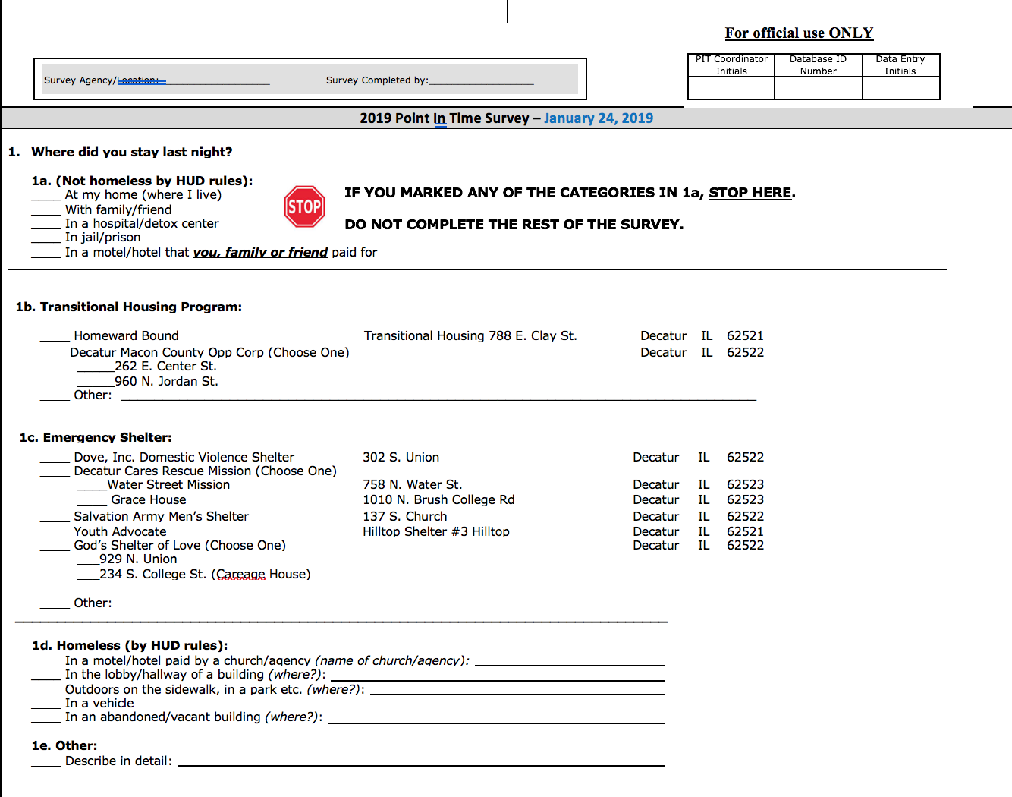

Slide 12
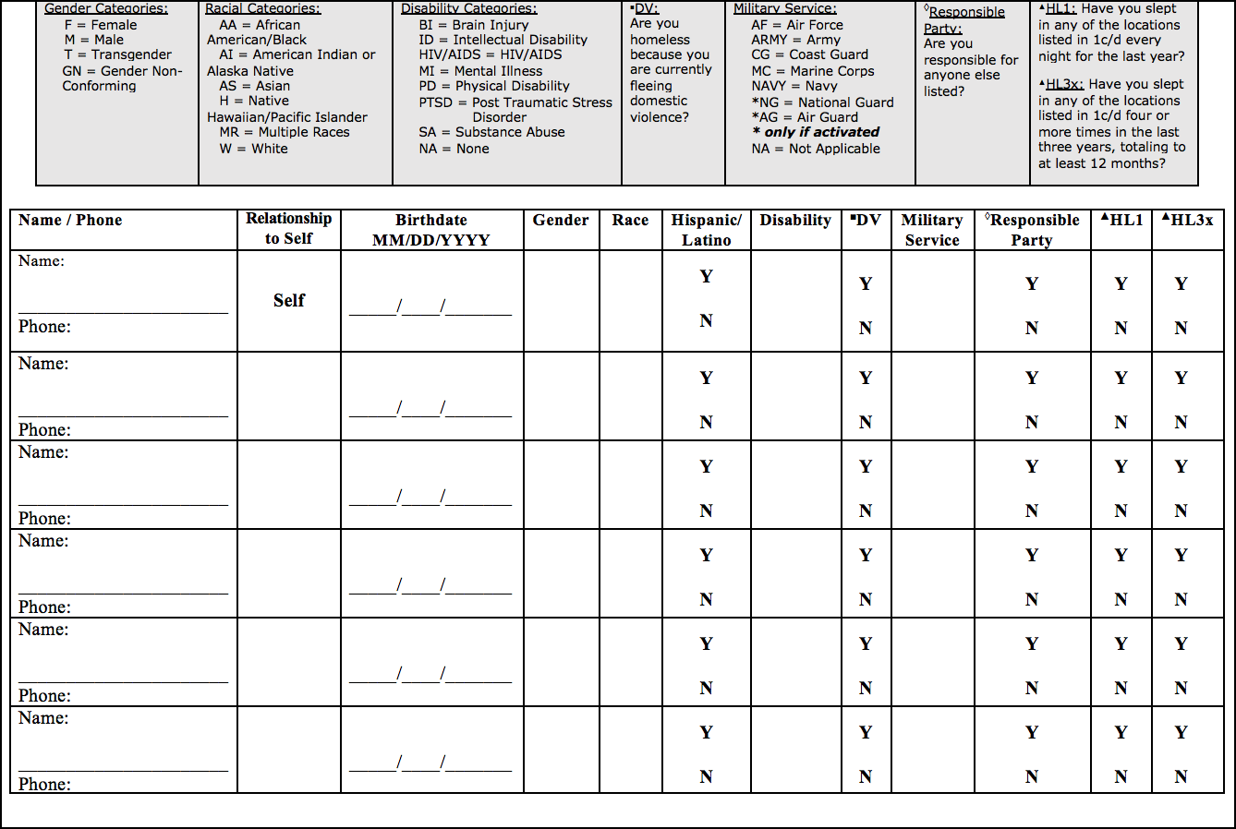

Slide 13

Drumroll…..

Slide 14
Macon County Homelessness
169 total individuals who identify as homeless
117 living in emergency shelter
41 living in transitional housing
11 identified as unsheltered

Slide 15
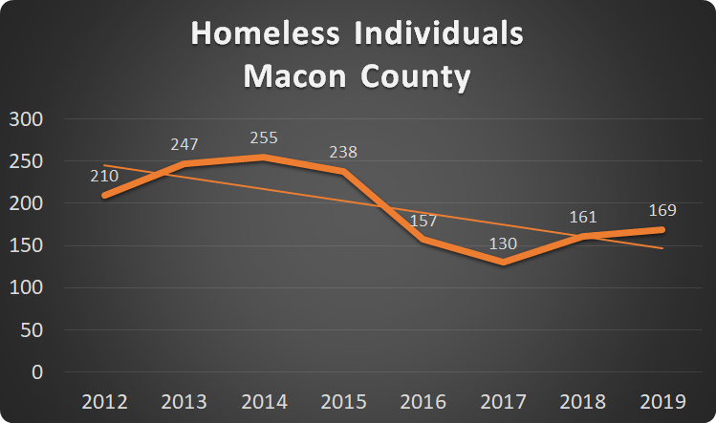

Slide 16
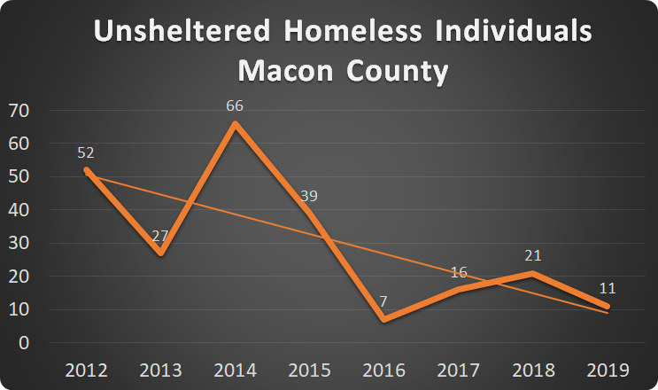

Slide 17
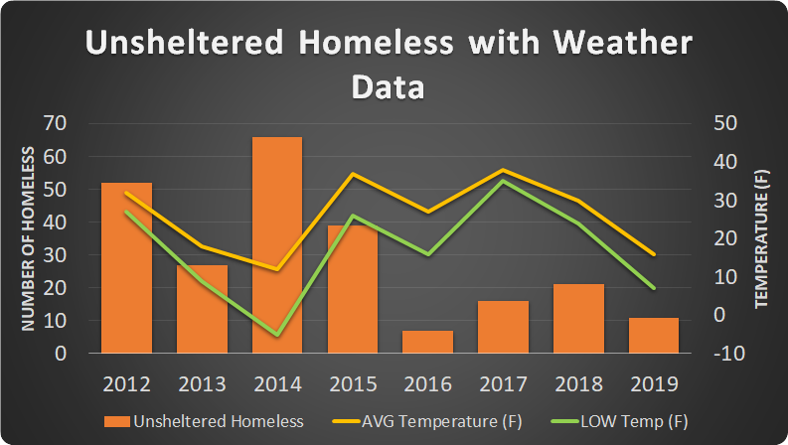

Slide 18
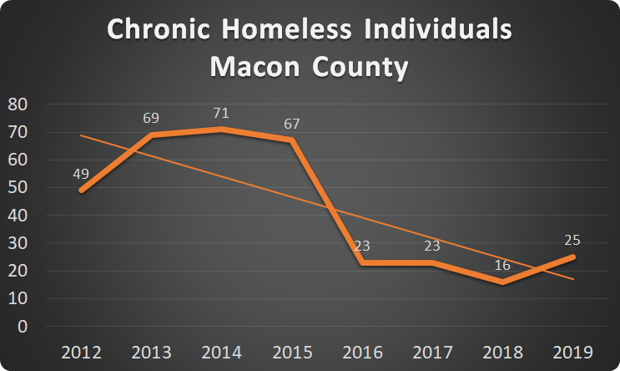

Slide 19
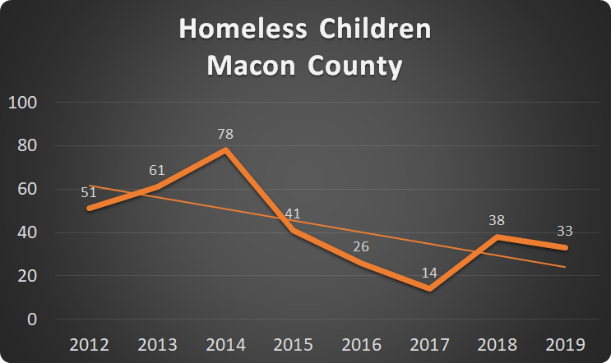

Slide 20
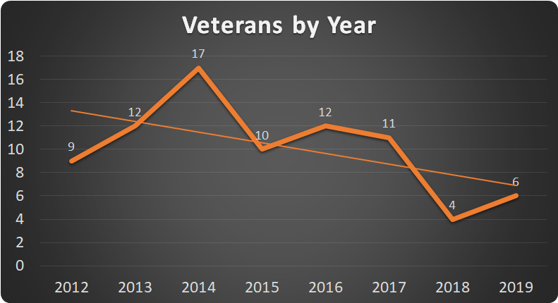

Slide 21
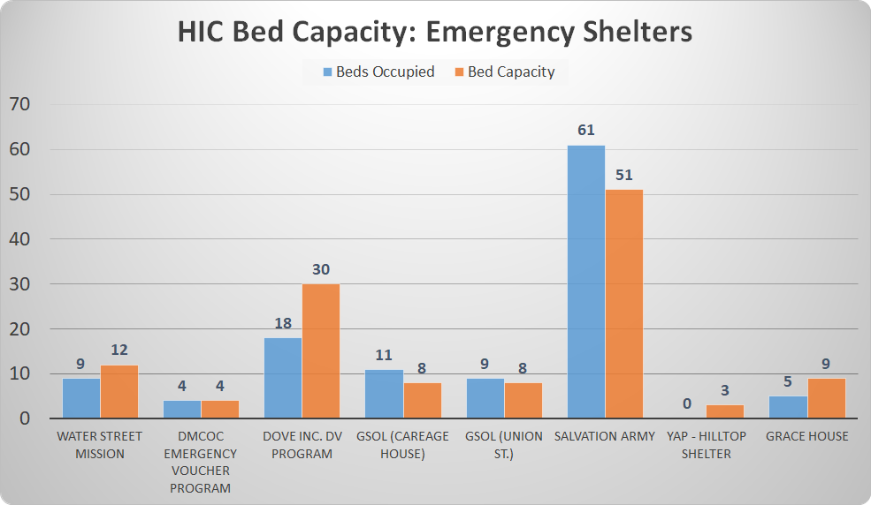

Slide 22
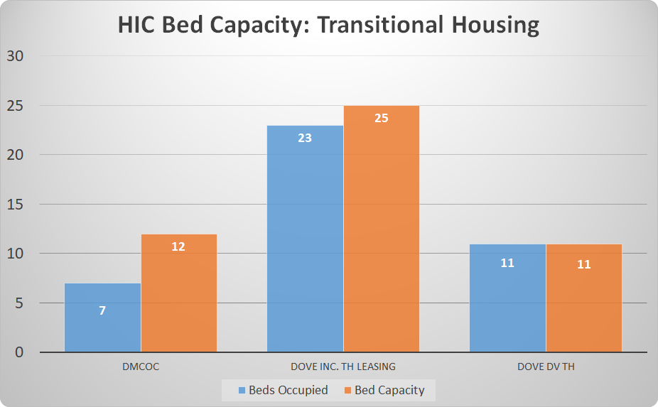

Slide 23
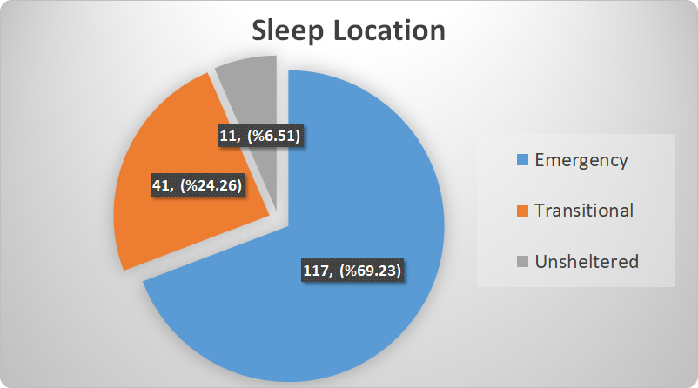

Slide 24
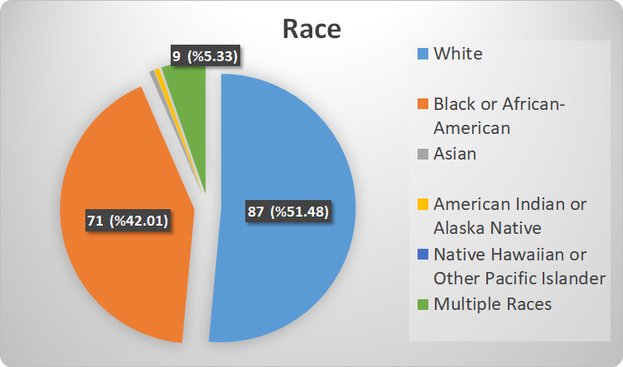

Slide 25
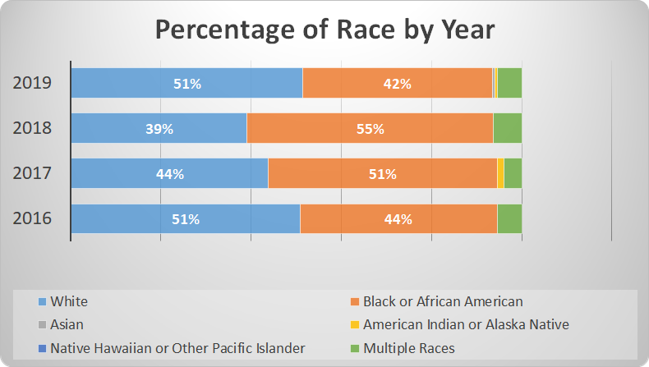

Slide 26
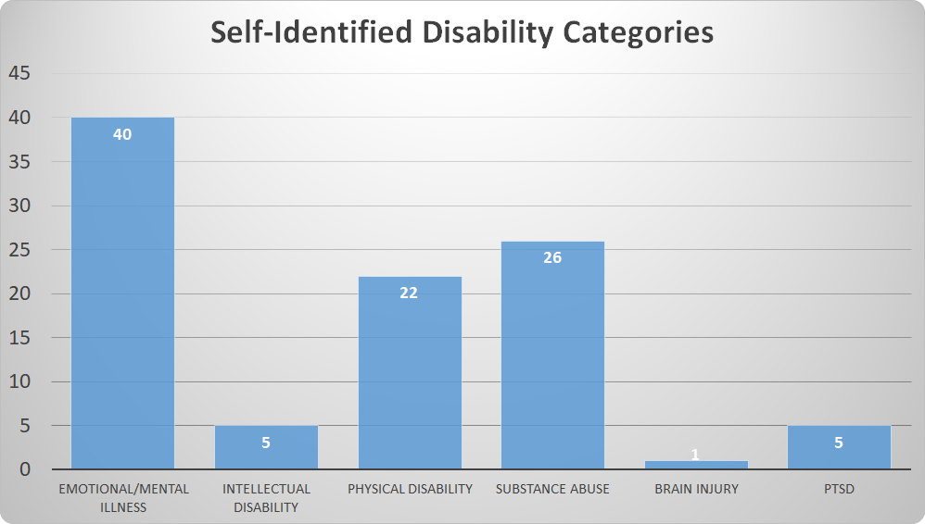

Slide 27
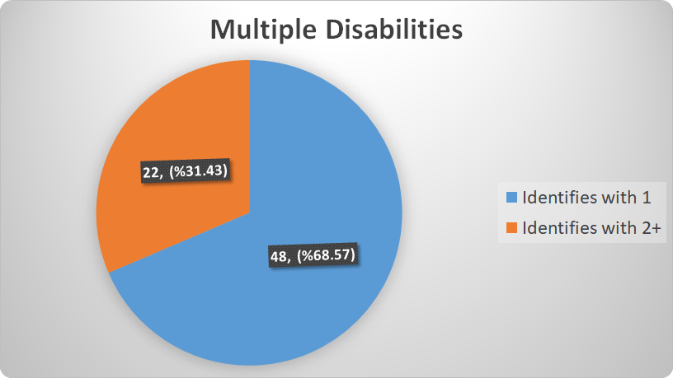

Slide 28
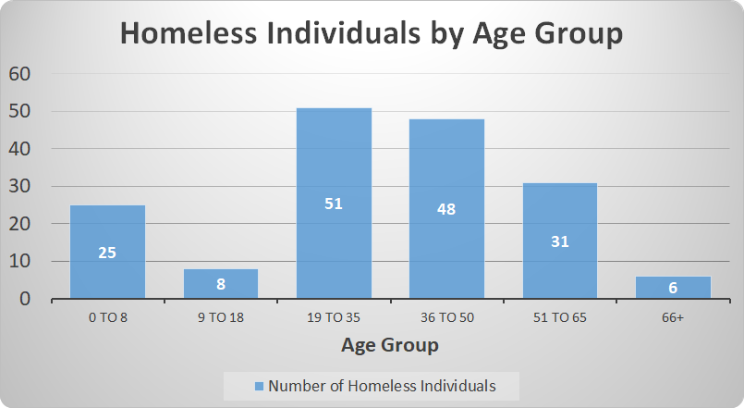

Slide 29
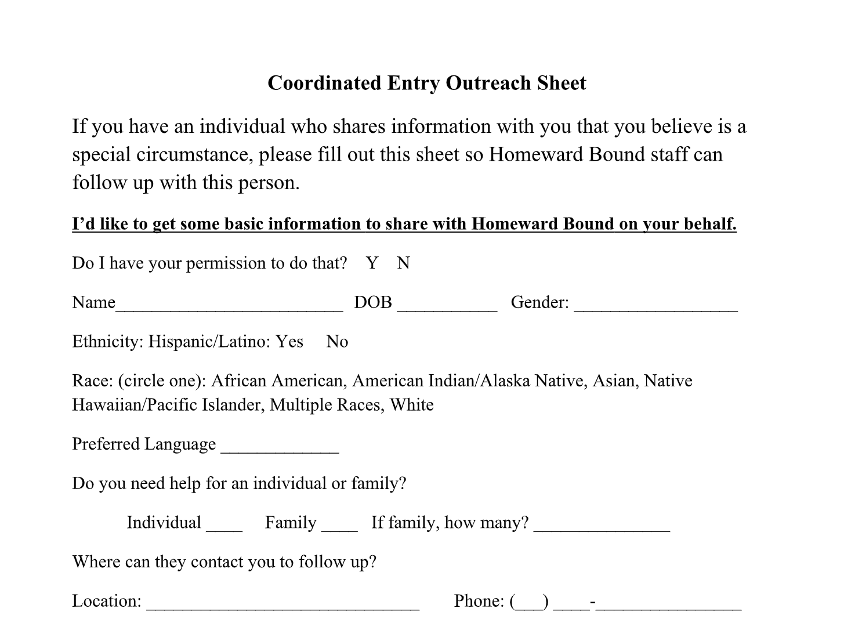

Slide 30
Discussion
Outreach (Homeward Bound)
ISST (Heritage)
Rise in homelessness
  Weather
  Discrepancies
Rise in chronic homelessness
Shelter use
New Individuals to community
Oasis
CHAT
Coordinated Entry

Slide 31
What are your questions?

Slide 32
Thank you!
To learn more about the CoC, annual PIT survey and HIC, please contact:
Homeward Bound Program Director Darsonya Switzer:
dswitzer@doveinc.org
Professor Mary Garrison:
mgarrison@millikin.edu

